Slide 1
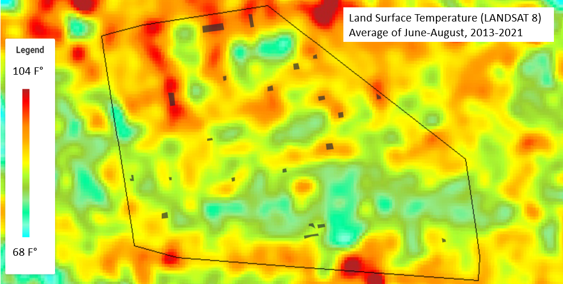
Urban Heat Island Research Group
Carolien Mossel
Professors Blake and Norouzi
+ Many more!

Slide 2
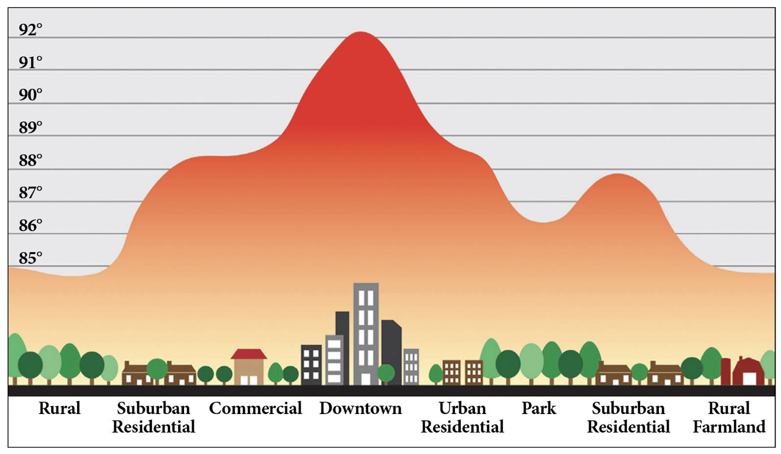
Urban Heat Island Effect
The urban heat island (UHI): Higher temperatures in urban regions compared to rural regions
UHI forms because of:
Concrete, asphalt, and other man-made materials absorb heat
Air pollution causes a warming effect
Lack of vegetation
Less wind
Characterizing Urban Land Surface Temperatures
NASA Sciences & Exploration Directorate, Earth Sciences Division, Goddard Institute for Space Studies, Goddard Space Flight Center: Climate Change Research Initiative, Office of STEM Engagement
Notes:
MW

Slide 3
What is our current research question?
What is the cooling impact (LST) of 2 community based urban heat island mitigation strategies:
(a) Community Gardens and (b) open Fire Hydrants?
Our study area is currently Bed-Stuy, Brooklyn, with potential to expand to NYC for future work.

Slide 4
Blue-Green Infrastructure Datasets- Hydrants and Community Gardens
Hydrants
Open fire hydrant locations through 311 requests via NYC Open Data
Community Gardens
GreenThumb via NYC Open Data
Size:
Half lot
Many lots
Composition
Flowering plants
Trees
Fruits and vegetables
Characterizing Urban Land Surface Temperatures
NASA Sciences & Exploration Directorate, Earth Sciences Division, Goddard Institute for Space Studies, Goddard Space Flight Center: Climate Change Research Initiative, Office of STEM Engagement
Notes:
MW

Slide 5
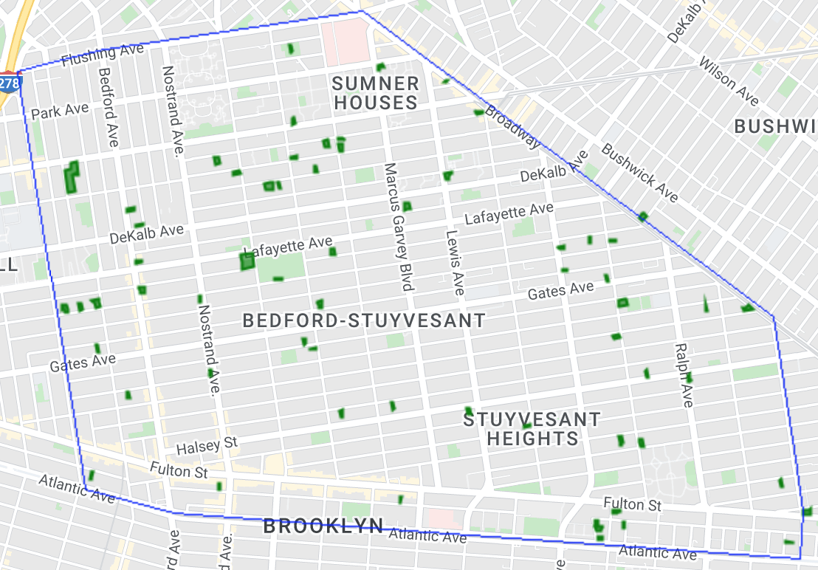
Results: Community Garden Investigations
Characterizing Urban Land Surface Temperatures
NASA Sciences & Exploration Directorate, Earth Sciences Division, Goddard Institute for Space Studies, Goddard Space Flight Center: Climate Change Research Initiative, Office of STEM Engagement
Notes:
MW

Slide 6
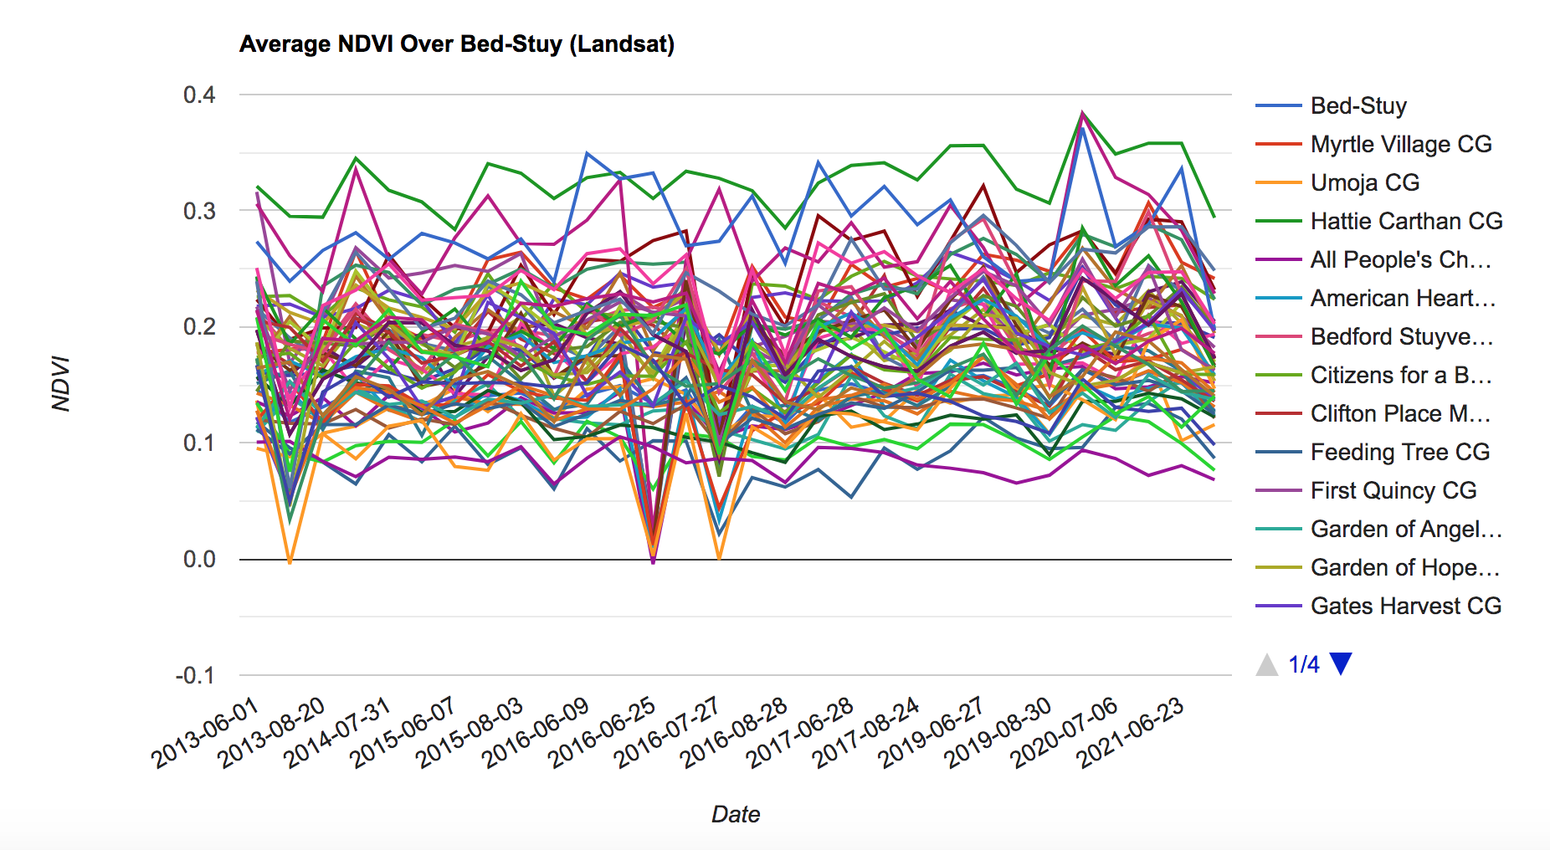
Results: Community Garden Average NDVI
Characterizing Urban Land Surface Temperatures
NASA Sciences & Exploration Directorate, Earth Sciences Division, Goddard Institute for Space Studies, Goddard Space Flight Center: Climate Change Research Initiative, Office of STEM Engagement
Notes:
MW

Slide 7
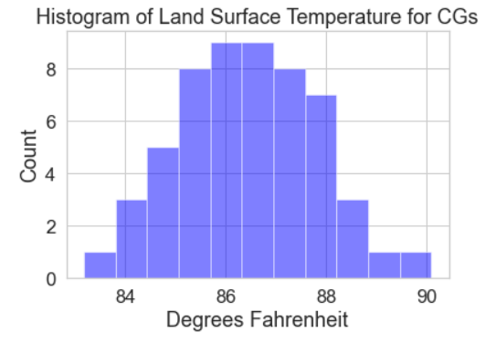
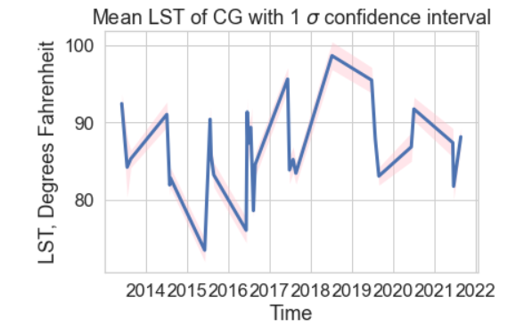
Results: Histogram of Community Gardens’ LST
N=54
Characterizing Urban Land Surface Temperatures
NASA Sciences & Exploration Directorate, Earth Sciences Division, Goddard Institute for Space Studies, Goddard Space Flight Center: Climate Change Research Initiative, Office of STEM Engagement
Notes:
MW

Slide 8
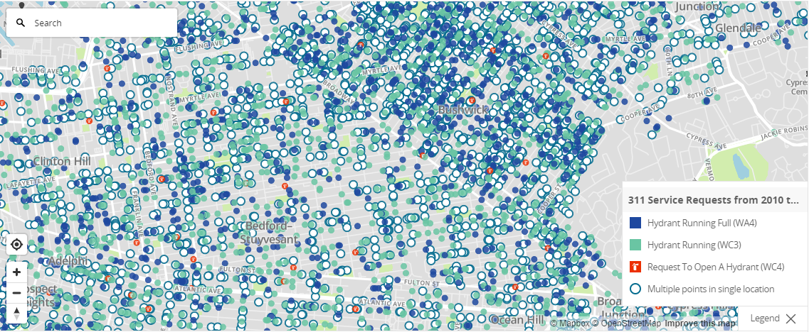
Source data- 311 complaints concerning Hydrants

Slide 9
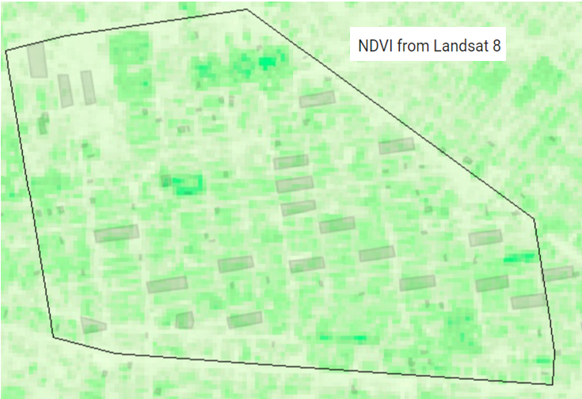
Community Gardens & Ungreen Blocks shown in gray

Slide 10
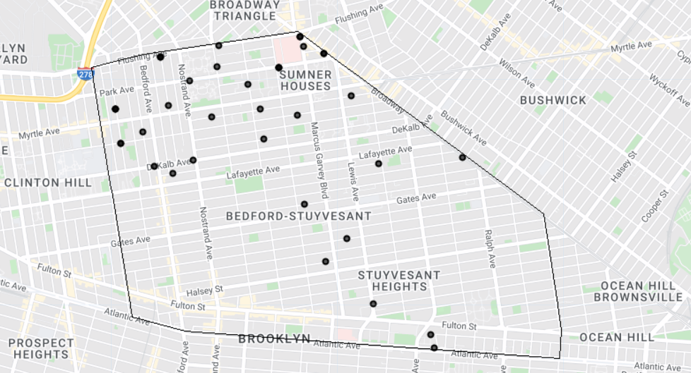
Map of Hydrant Dataset
Hydrant locations that were “on” within BedStuy in the Summer of 2020
Characterizing Urban Land Surface Temperatures
NASA Sciences & Exploration Directorate, Earth Sciences Division, Goddard Institute for Space Studies, Goddard Space Flight Center: Climate Change Research Initiative, Office of STEM Engagement
Notes:
CM

Slide 11
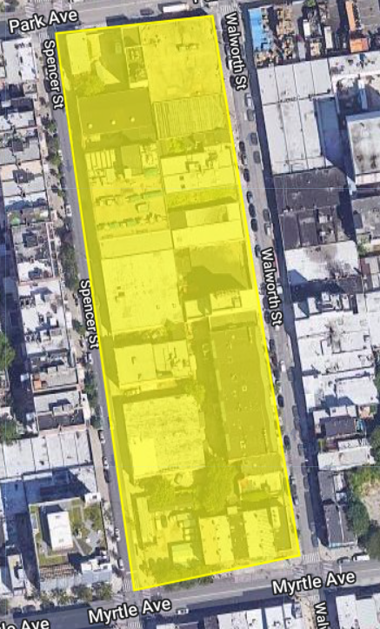
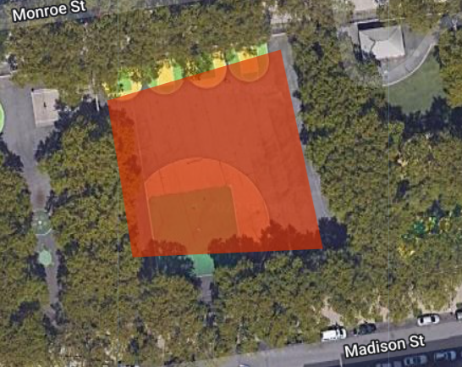
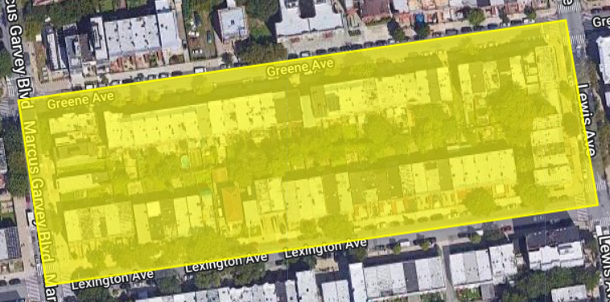
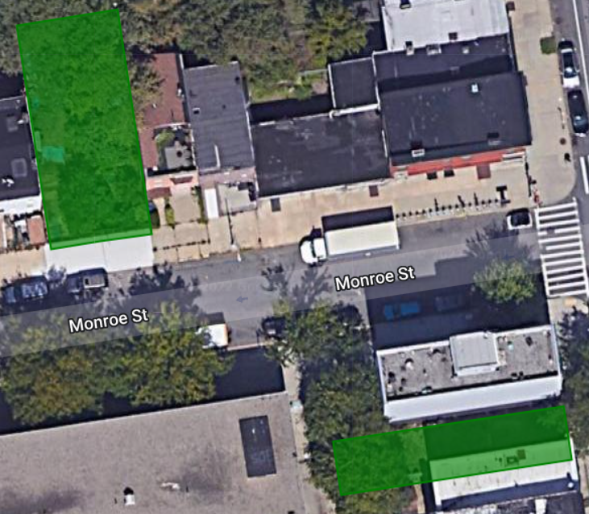
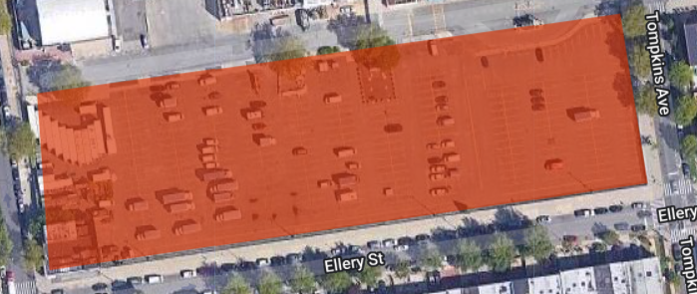
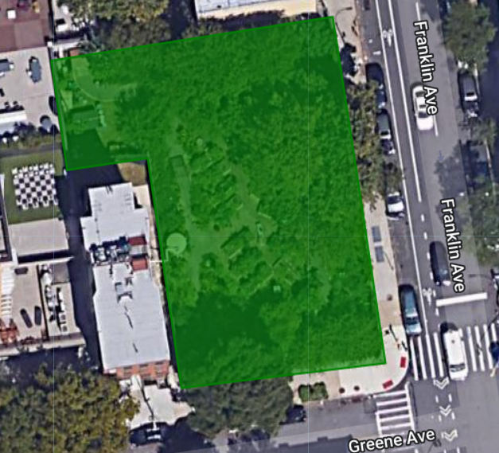
Potential Result Explanation: Site Heterogeneity
Legend
Community Gardens
Ungreen Blocks
Pavement
Characterizing Urban Land Surface Temperatures
NASA Sciences & Exploration Directorate, Earth Sciences Division, Goddard Institute for Space Studies, Goddard Space Flight Center: Climate Change Research Initiative, Office of STEM Engagement
Notes:
CM

Slide 12
A successful intern in our group will be interested in the following:
Python heavy work this summer
ONLY APPLY IF HIGHLY MOTIVATED TO CODE IN PYTHON EXCLUSIVELY
Working with gridded satellite products
Land surface temperature, vegetative index, water index
Working with Google Earth Engine API in Python
Possible opportunities to record land surface temperature with drones!

